Slide 1
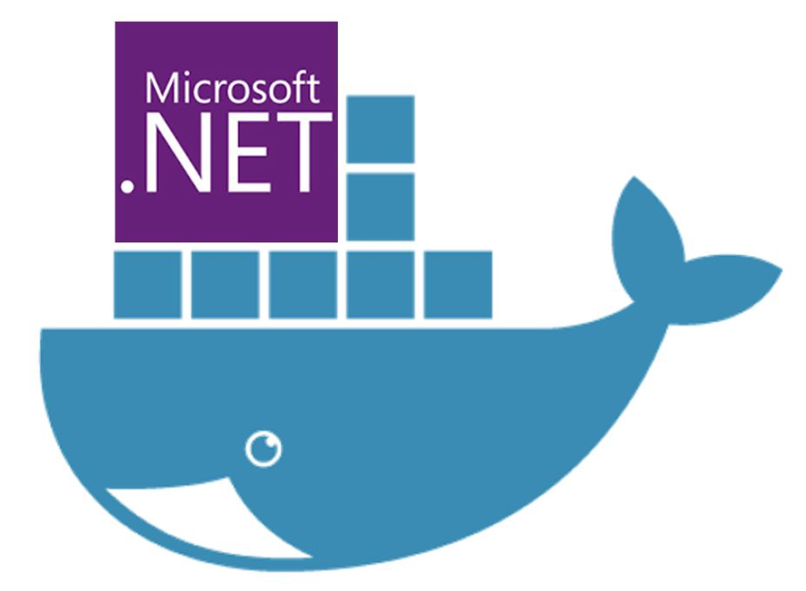
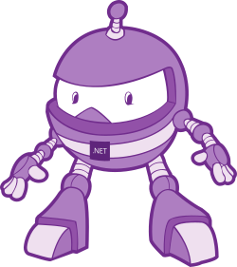
Dockerising .Net applications
Simplifying software delivery for .Net Devs (even if your boss says you can’t use Docker!)
Slides & code available on Github: https://bit.ly/2EO2lth (case sensitive!)
Notes:
Today we are going to learn just enough Docker to be useful.
We’ll learn how to get your .Net applications running in Docker, and what that actually means.
We’ll discuss some common use cases that could help your team be more productive.
We’ll see how to get several dockerised applications talking to each other.
And we’ll touch upon how to get your dockerised application into production.

Slide 2

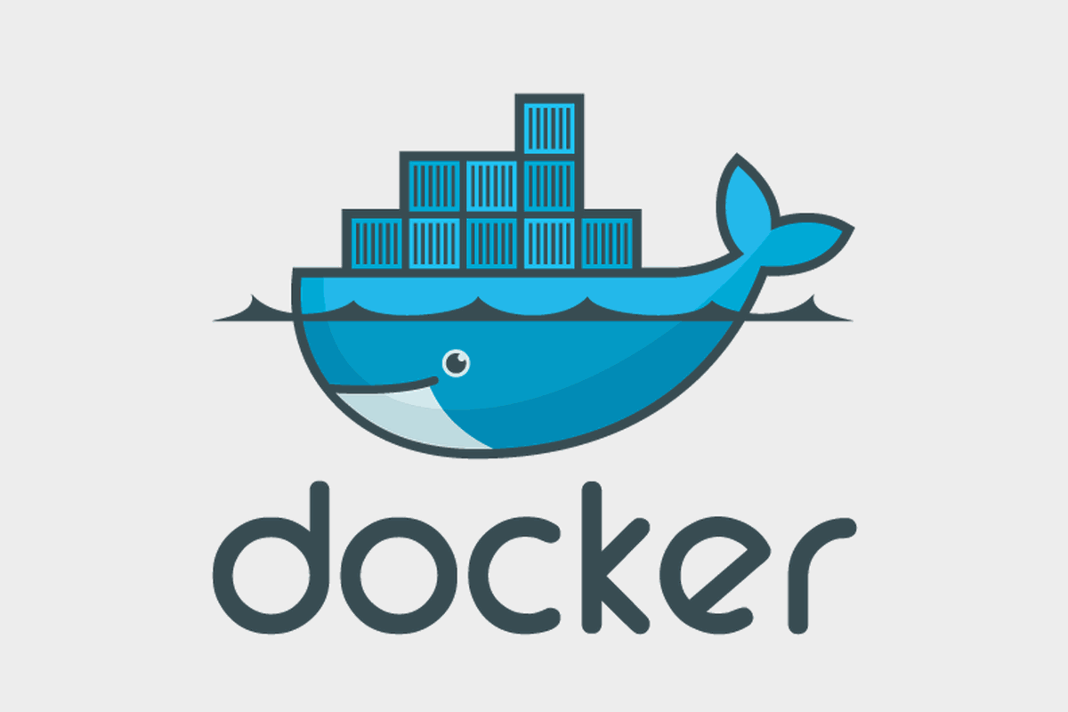
What is Docker?
Notes:
Now a logical way for me to start this talk is to translate the sales pitch on the docker website into simple explanations.
Instead, I’d like you all to think about your first day in a new job, or on a new team, or that open-source project you want to contribute to…
You’re eager to get stuck in…
Your first Job, setting up your Dev environment.

Slide 3
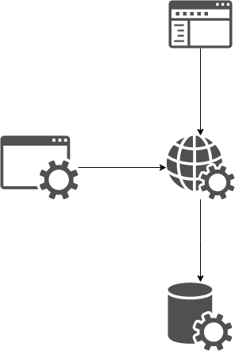
Context: Our Application Stack
Web
Front end
Web
API
Automated
Tests
Database
Notes:
Here is the project you are going to be working on.
A typical 3 tier CRUD application: a database, behind a web service, feeding a front end….and some automated tests to make sure everything is working.
If you are lucky there is a setup document telling you what you’ll need installed, and how to configure it.
If you are REALLY lucky, setup is scripted for you, and the setup document is simply a list of scripts to run and in what order.

Slide 4


Setting up you Dev Environment
==
Notes:
But how often are these setup documents out of date and missing steps?
How often does something already on the machine conflict with what you are trying to setup?
Wouldn’t it be nice if the setup document was a single instruction?
Docker helps remove all of this pain and achieve just that.
With Docker, I can clone a code repository to my machine and be up and running in minutes.
I don’t need .Net installed.
I don’t need a database installed.
I don’t need IIS or virtual directories (at least, not with .Net Core)
I just need Docker and the source code.

Slide 5
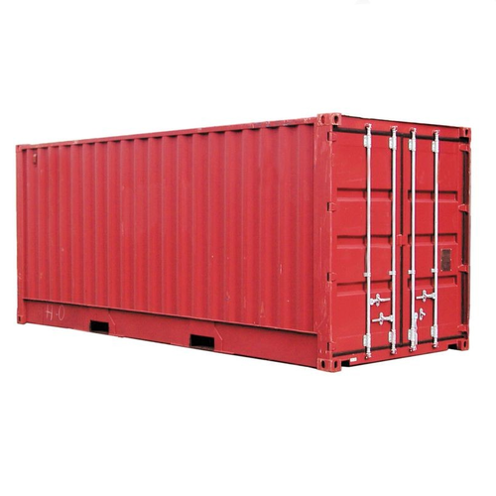

Same Stack, but running in containers
Notes:
Time for our first demo.
Having just pulled our source code from github,
I will run a single command and launch our entire application within Docker Containers.

Slide 6
Demo 1
Notes:
./run.sh

Slide 7
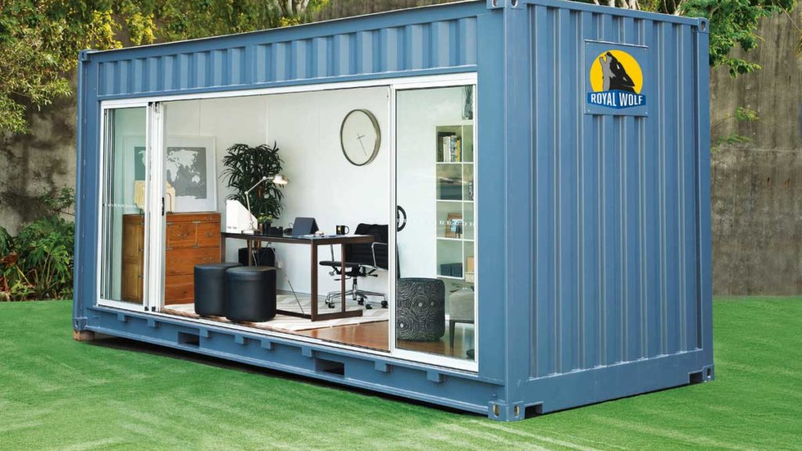
Use cases for Docker
Notes:
Now that you have seen Docker in action, you probably have a few ideas about how you can use it within your teams.
Here are a few ways that I’ve seen it used in order to make teams more productive.

Slide 8

QA / Testers
Notes:
Testers/QA.
Typically they maintain suites of automated tests that ensure a system is working to spec.
And these tests will usually run in some sort of CI pipeline somewhere.
But they are created and maintained on QA’s local dev environment.
With Docker, they no longer need to worry about maintaining a working Development environment.
They can simply launch the whole system with Docker, and start writing and running tests against that stack.
They can focus on what is important to them, without the worry of keeping the environment up-to-date with new versions.

Slide 9

UI Devs
Notes:
UI Devs.
Their focus is on CSS and Markup.
They shouldn’t need to worry about what version of .Net is installed, or what version of the Database they have.
Docker allows them to focus on what is important to them, by simplifying the build and run process.

Slide 10

Devs
Notes:
Devs/Engineers:
When implementing changes to part of a system, we no longer need to host all of our downstream dependencies within your IDE.
Instead, you can launch these dependencies in the background in Docker.
This helps to reduce the feedback look by reducing what you need to recompile and test locally.
This is really useful in polyglot, or microservice teams.

Slide 11
Context Switching
Application Y:
MVC
Web API
SQL Server
Application X:
React
Node.js
Mongo
Notes:
I’ve been using Docker for about 2 years now, and I’ve made a few observations along there way.
I think that Docker helps lower the barrier to entry for new or unfamiliar Tech.
For example, before I learnt any Node, I was able to launch a Node service within Docker, point my app at it and start consuming it’s endpoints without needing to learn anything about Node, or NPM.
I was productive much faster than I would have been without Docker.
I’ve also found that Docker reduces the overhead of moving from one project to another, which I often do on my team as we run ~18 microservices in both .Net and Node.
It is really useful being about to move from service to service, using the same commands to launch the various solutions, regardless of tech used.

Slide 12

You can’t use Docker! (In Prod)
Notes:
All of these advantages, and we’re not even close about talking about Production yet.
So, if you’ve ever been told you can’t use Docker (meaning Production),
It doesn’t mean you and your team can’t benefit from using it elsewhere!

Slide 13
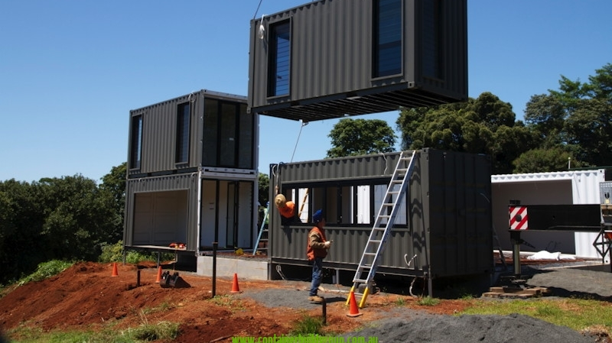
Building Containers
Containers are running instances of Images
Images are created from a Dockerfile
Dockerfiles contain instructions of how to build you application
Notes:
In the demo, we launched multiple dockerised applications at once.
But in order to explain that, first we need to know how to get a single app into Docker.
When we Dockerise an application, what we really mean is that we are running it within a Container.
Containers package up our software, and all of it’s dependencies, into a single, portable package.
So that means things like our Dlls and configuration, but it also means the version of the .Net runtime that it requires to run, and even the operating system that the runtime needs.
Containers ship with EVERYTHING then need to run, so that when you start one up it have everything it needs.
And Containers will run anywhere that Docker is installed, even if .Net is not installed too.

Slide 14
Building Containers
Dockerfile -> Image -> Containers
Notes:
So how do we get our apps inside a Container?
First you need an Image. Containers are actually running instances of an Image.
Images are like blue-prints and define everything your Container needs to run.
You build an Image from a Dockerfile, which contains all the instructions needed to create your Image.

Slide 15
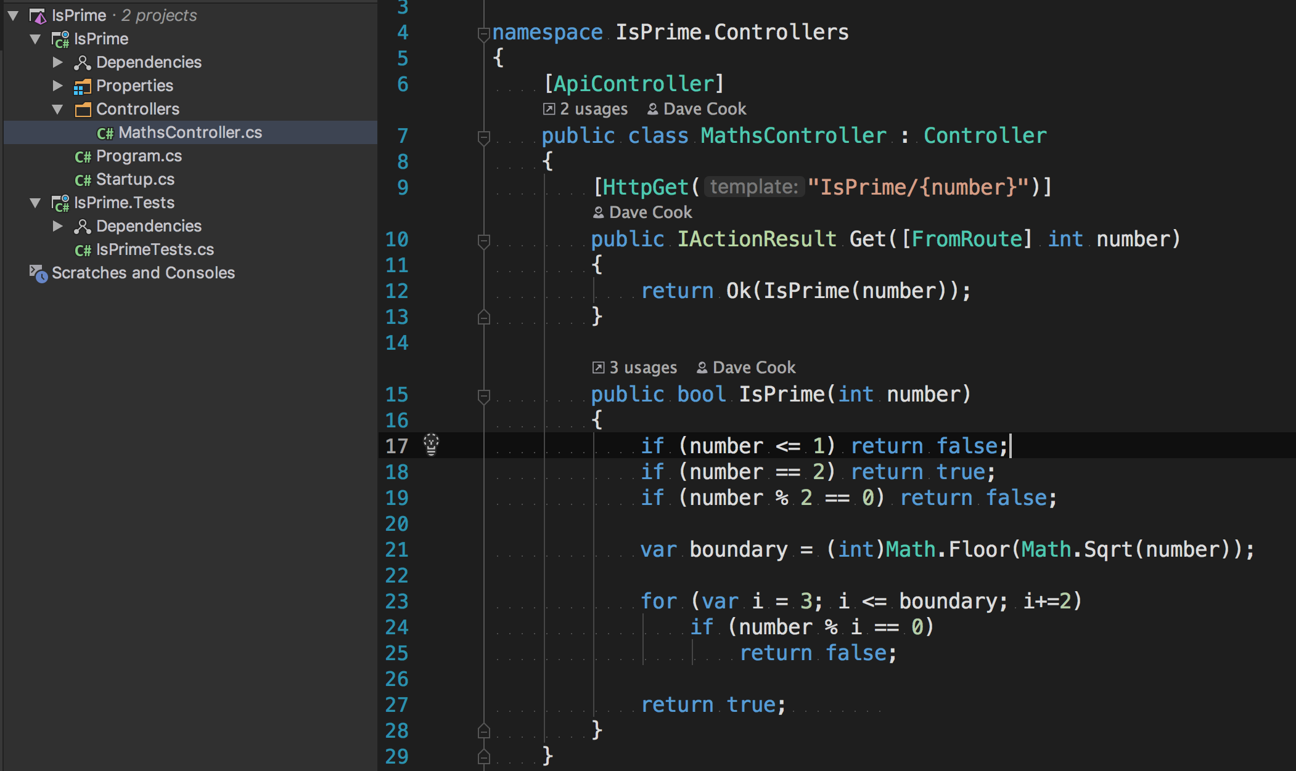
Context: Our Sample service
Notes:
We’ll see our first Dockerfile in a mo, but before that, we need a little context on the application we are going to Dockerise.
It’s a simple Web Api Server, with a single HTTP Get endpoint, which evaluates if the number on the URL is a Prime Number or not.
On the Left you can see our solution consists of two projects, 1 for our Api and one for the tests.
On the right you can see the source code.
Super simple stuff: I’ve omitted things like error handling and validation for clarity.
The service runs on port 9021, which will become relevant shortly.

Slide 16
Our Dockerfile

Slide 17
Build an Image
docker build -t isprime_dotnetcore:1 .
Notes:
Now we have a Dockerfile, we need to use that to create an Image.
We do that with the Docker build command.
We are passing it 2 args:
The 1st, -t, is the name and tag combination that we will use to referrer to this Image once it’s created.
The 2nd, a full stop, is what’s know as the build context, and is actually reference to the current directory.
It says to the Dockerfile, execute all your commands within the context of this path.
As we have not actually specified a Dockerfile to use, Docker is defaulting to look for a file called ‘Dockerfile’ in the current directory.

Slide 18
Demo – Build an Image
Notes:
docker build -t isprime_dotnetcore:1 .

Slide 19
Start a Container
docker run -p 80:9021 isprime_dotnetcore:1
Notes:
Now we have an image we can spin up a container instance to host our app.
We do that with the Docker run command.
Again, we are passing 2 args.
The 1st –p, mapps port 80 on our Host machine to port 9021 on the image, which is where our application is actually running.
The 2nd, is the name and tag combination of the image that we want an instance of, which is the same as the Image we just created.

Slide 20
Demo – Start a Container
Notes:
docker run -p 80:9021 isprime_dotnetcore:1

Slide 21
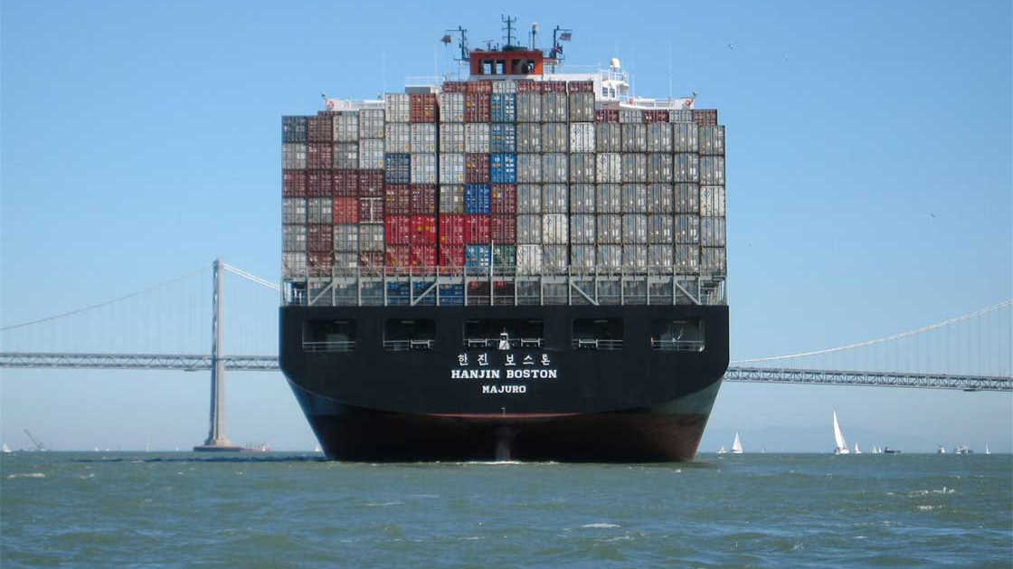
Docker Compose
Notes:
So now that we know how to build an Image containing our application, and launch an instance of a Container, it’s time to go back to where we started with our First Demo.
We used a tool called Docker-Compose to build and launch multiple Containers with a single command.
It does this by allowing us to define multi Container applications in a YML file.

Slide 22
Docker Compose YML
Notes:
Lets have a look at the compose file we used in that demo

Slide 23
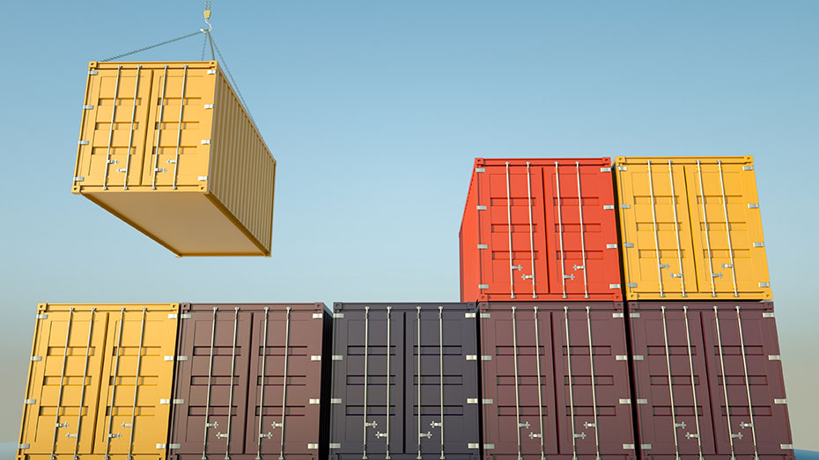
Road To Production
Notes:
So you now know how to use Docker locally, but what about Production?

Slide 24
Automate your build process
Images created locally are throw away artefacts
Automate the build & publish of Images
Build agents/ CI servers don’t need .Net installed
Can deploy to anywhere that Docker is installed
Notes:
While you will perform all the tasks we’ve seen here today locally, in reality you will be using some sort of CI process to automate you Build process.
Something like Jenkins or Azure Pipelines will actually build your images for you and publish them to your Docker Repository.
Once in Docker, deploying to a new environment is as simple as downloading the Image and performing a Docker run.
Again, you’ll likely automate this.
Your target environments and build agents do not need .Net installed, as the Images contains everything they need to run.
As long as Docker is installed, deploying to a new environment is easy

Slide 25
What this means for Devs
Images created locally are throw away artefacts
Automate the build & publish of Images
Build agents/ CI servers don’t need .Net installed
Can deploy to anywhere that Docker is installed
Notes:
What this means for use Devs is:
We are no longer dependent on sys Admins to configure test and Production servers in readiness for our apps
We have complete control over the versions of software that we use:
No more being stuck on version X of Y because team A uses the same kit – each container is completely isolated from the next.
Deployments are fast and repeatable, and we can react quickly to spikes in traffic by spinning up new instances to deal with the load.
We can also avoid vendor lock in, as Docker is supported by all the major cloud providers.
You can even run it on prem

Slide 26
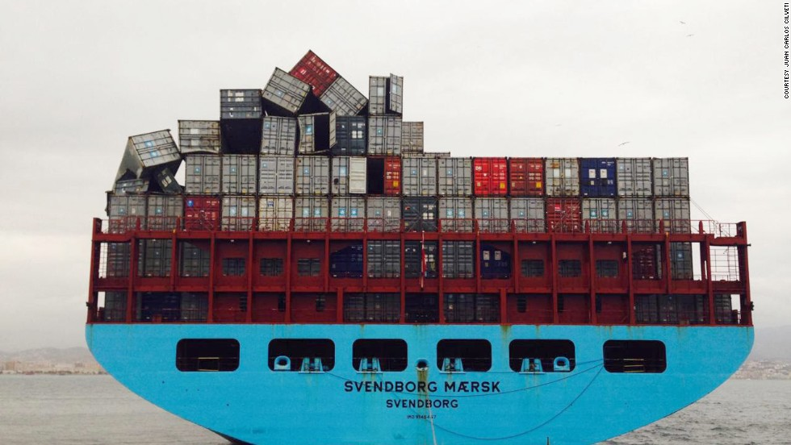
New Challenges
Notes:
However, choosing to adopt Docker will also bring some new challenges to overcome.
Here are a few things you’ll need to consider

Slide 27
Things to consider
Learning curve
Managing Containers is not Free
How do you access your logs?
Can I log on to live servers?
Notes:
There is a learning curve, especially if you are historically a Windows person with little experience of Linux systems.
Managing containers goes not come for Free, you’ll need to figure out how you monitor instances, stop old instances when deploying, manage load balancers, restart stopped containers.
Basically, you’ll need to relearn how to run your software in the wild.
You’ll need to figure out how to access your application logs in order to diagnose any issue in production, which is going to be tricky if you can’t even log on to your Live servers.
The good news is though, that you can practice and experiment on internal environment and processes to find what works you.
Make mistakes and answer these sort of questions before you even start thinking about Production.
You don’t need to go ‘All In’ on day one.

Slide 28

Fin!
Notes:
That’s it.
You should have everything you need to go and start playing with .Net applications in Docker.
There are other ways to do things that’ve I’ve not had time to cover, and there are things such as security that I’ve not touched on,
But you should have everything you need to get started and avoid some pitfalls.

Slide 29

Quick Plug, then Questions
www.dddeastanglia.com/
Notes:
Before we go to questions, I thought I’d take a moment to plug a local developer conference that I help organize.
DDD East Anglia is a free to attend, community led Developer conference hosted in Cambridge.
It’s actually not a .Net specific event, but a lot of the talks given are on .Net topics.
We have just opened our call for papers and are looking for a speakers for September.
So if you would like to do a talk, or simply want to listen, check out the site for more info, it would be great to see some new faces there.

Slide 30



Questions?
https://medium.com/@dcook_net
@dcook_net
https://github.com/dcook-net/
Slides & code : https://bit.ly/2EO2lth

Slide 31
Resources
Exploring Net Core Docker Files - Andrew Lock
Docker for .Net Developers (7 part Series) - Steve Gordon
Announcing the Microsoft Container Registry - Rich Lander
How To Build a Smaller Docker Image – Medium
What's wrong with Latest and The misunderstood latest tag
Play with Docker Classroom - Dockers Labs
https://docs.docker.com/engine/examples/dotnetcore/

